Slide 1
Seven Testing Principles

Slide 2
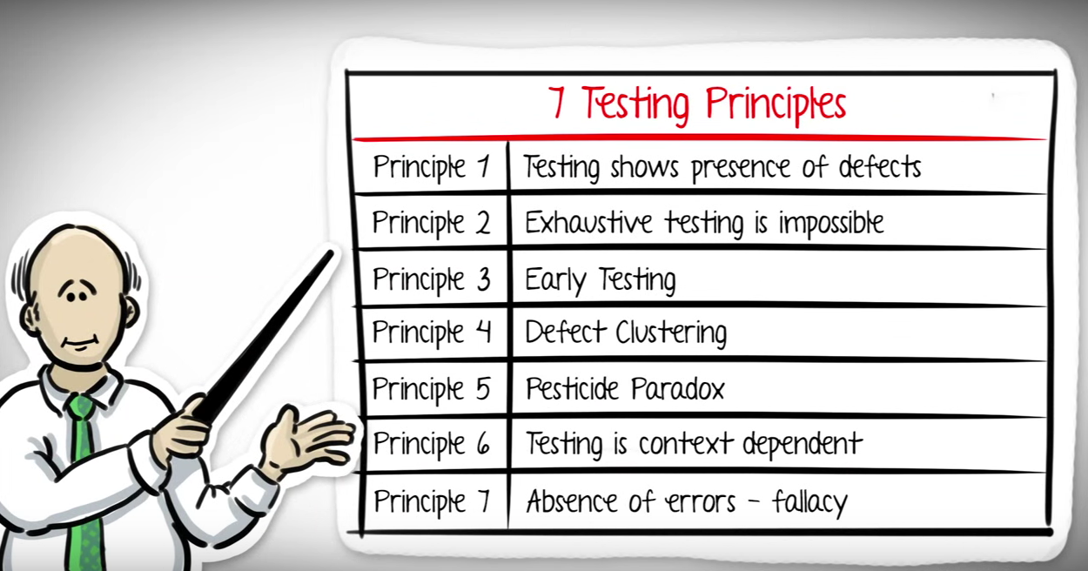
Test Design
Test Execution
Analysis and Reporting
Test Planning

Slide 3


Slide 4


Slide 5
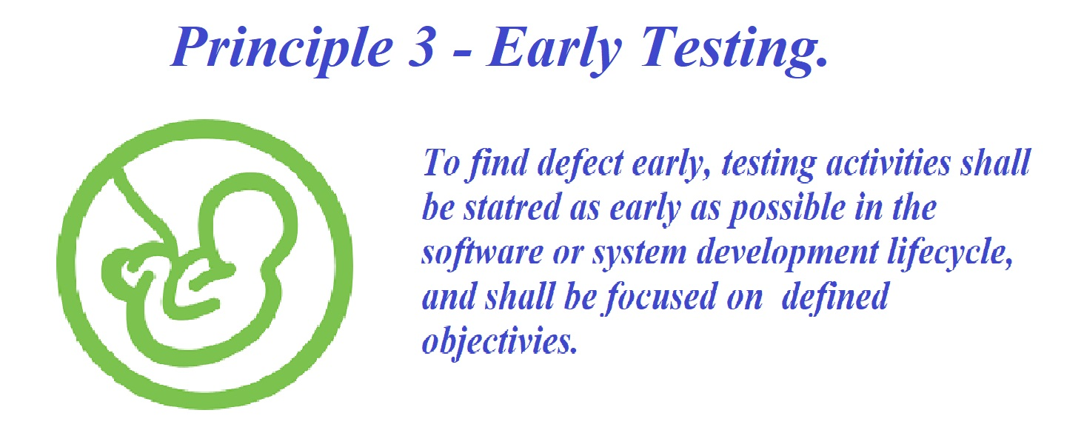

Slide 6
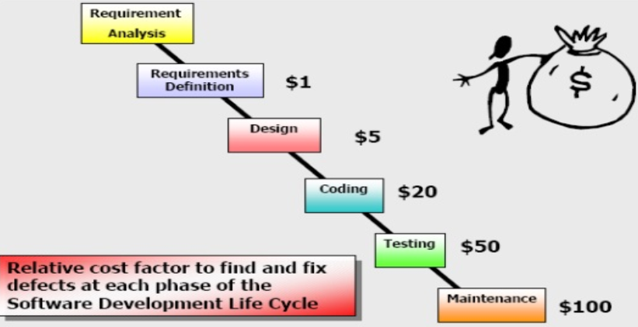

Slide 7
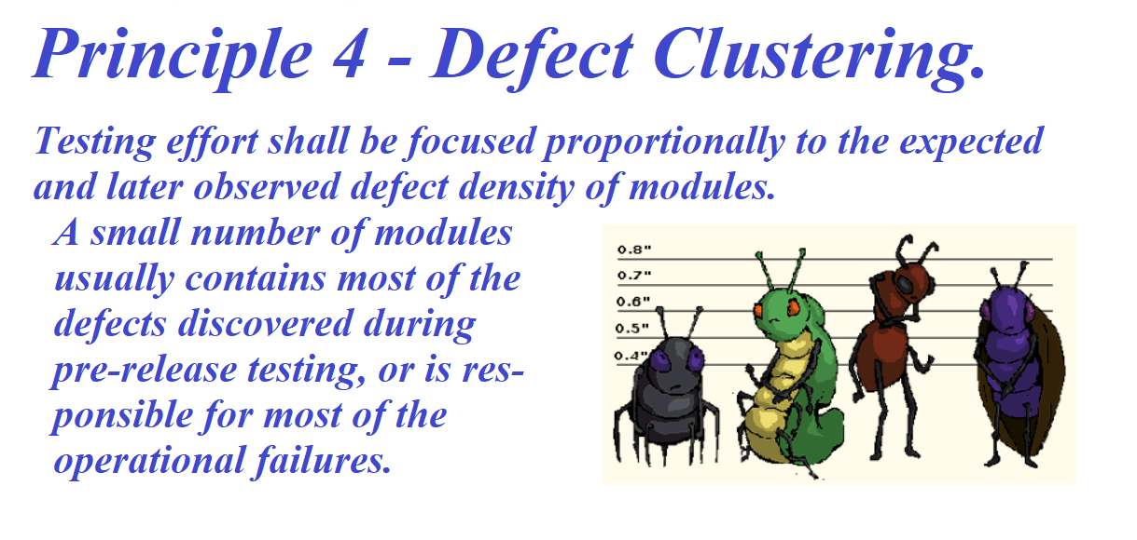

Slide 8
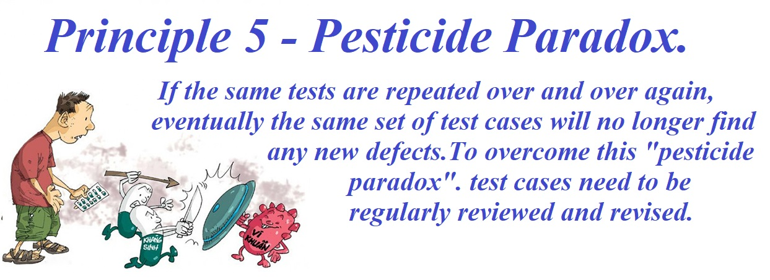

Slide 9
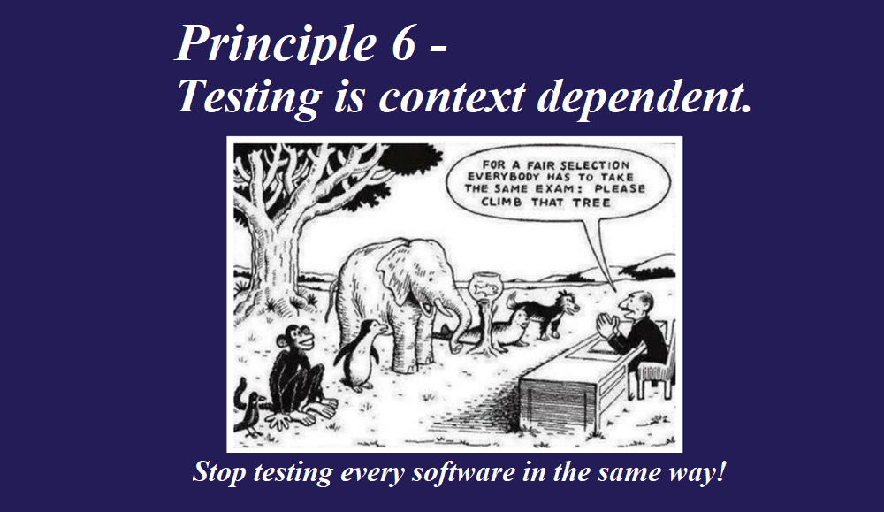

Slide 10


Slide 11
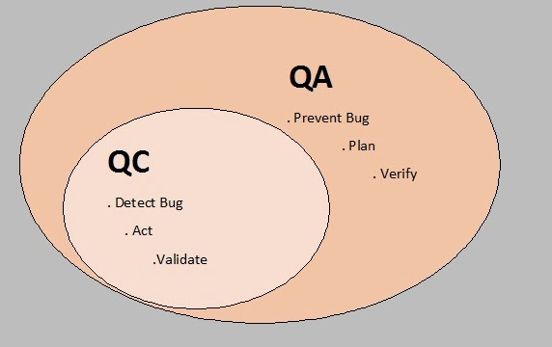
Quality Control and Quality Assurance

